Slide 1
Sino-Hungarian
Economic Cooperation Area Development
- A platform for further economic cooperation
26th Mar, 2015

Slide 2
Topics
:
Opportunities from One Belt One Road and internationalization of Chinese RMB
Wanhua-BorsodChem’s development and Sino-Hungarian Borsod Economic Cooperation Area Development Company Limited

Slide 3
Opportunities from One Belt One Road and internationalization of Chinese RMB
Rapid development of its economy and strong position of RMB→ China from importer to exporter of capital
One Belt One Road strategy
China’s capital investment and its strategic initiative →Opportunity for related regions, countries and companies
Preliminary data from Chinese government shows China’s 2014 GDP exceeds $1 trillion with a growth of 7.4%, which makes China the second trillion-maker after America
Asian Infrastructure Investment Bank and $40 billion Silk Road infrastructure fund
The Fund aims to support countries along One Belt One Road route with infrastructure, resource development and industrial cooperation
Cooperation economically and integrate in politics and culture
Hungary is one of the countries along the route which will bring new opportunities for BorodChem and Wanhua’s investment

Slide 4
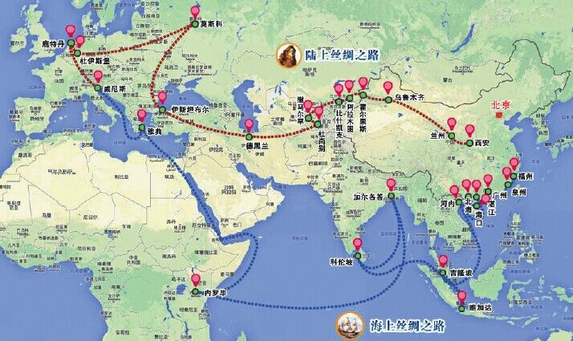
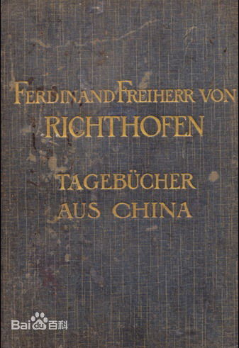
Opportunities from One Belt One Road and internationalization of Chinese RMB-history of the Silk Road
The silk road
The silk road is an ancient network of trade routes that linked Asia, Africa and Europe. From the transportation, it is spited into the route on land and the route on the sea. The silk road has been facilitating economic, political and cultural communication between the east and the west with China’s silk and porcelain as the main trading items at the beginning. The name "Silk Road" was adopted in the 1970s by German geographer Ferdinand Freiherr von Richthofen.

Slide 5
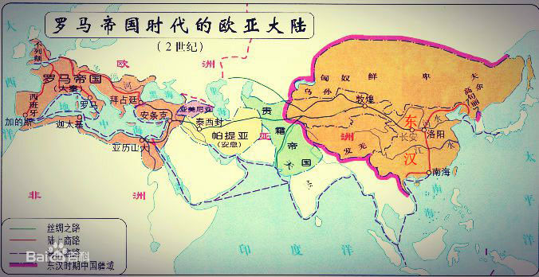
Opportunities from One Belt One Road and internationalization of Chinese RMB-history of the Silk Road

Slide 6
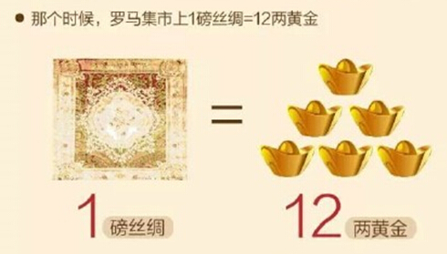
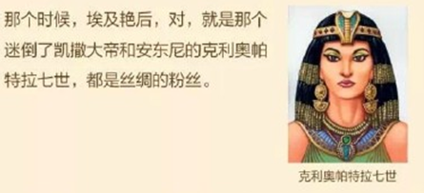
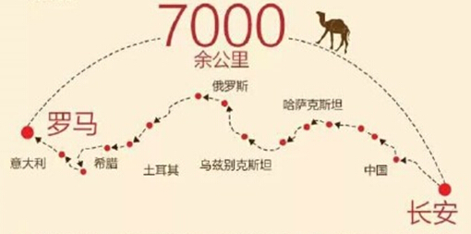
Opportunities from One Belt One Road and internationalization of Chinese RMB-history of the Silk Road

Slide 7
Opportunities from One Belt One Road and internationalization of Chinese RMB-the new Silk Road
This area covers 4.4 billion population, the aggregate economic volume reaches to $21 trillion.

Slide 8
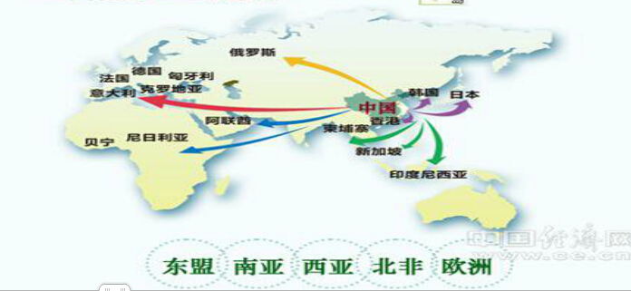
Opportunities from One Belt One Road and internationalization of Chinese RMB-the new Silk Road
$40 billion Silk Road infrastructure fund
Asian Infrastructure Investment Bank

Slide 9
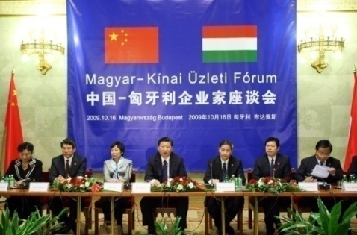
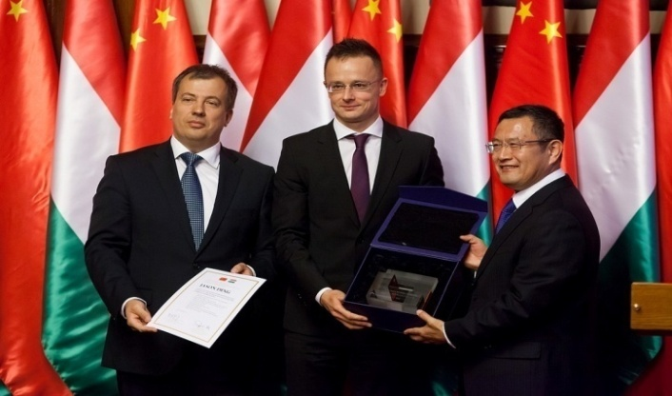
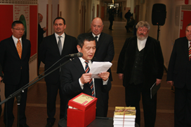
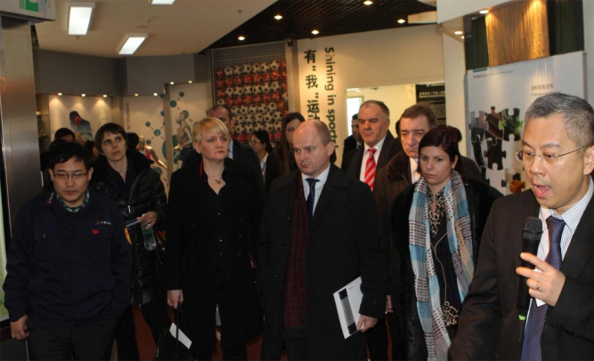
Introduction of Wanhua- BorsodChem
Full acquisition in 2011, with great support from Chinese government
April 2012 Premier Li Keqiang visited Hungary and affirmed Wanhua’s contribution in promoting Sina-Hungarian capital communication.
November 2013, Premier Li Keqiang visited Europe on the China-CEEC Summit in Romania and mentioned Wanhua investment in Hungary on his meeting with other leaders
Visited by foreign Officials and Representatives from 14 middle and east Europe countries
Sino-Hungarian Friendship Reward
Chinese Center established with Wanhua’s support

Slide 10
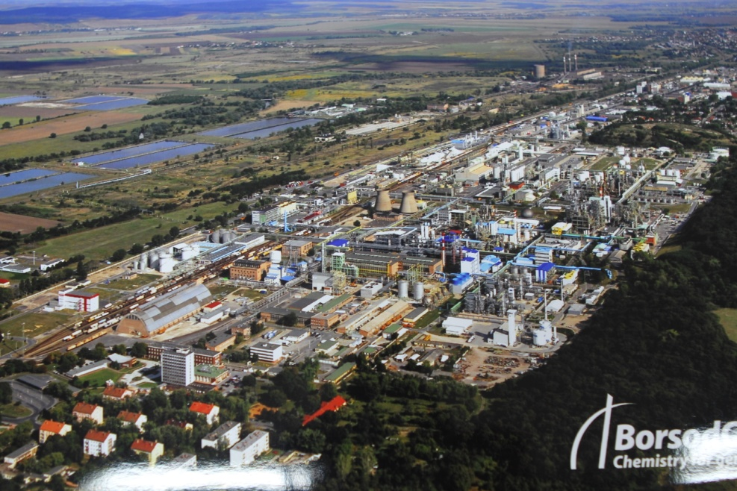
Introduction of Wanhua-BorsodChem

Slide 11
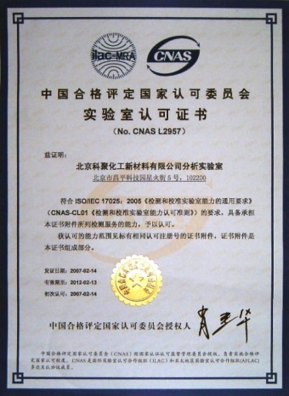
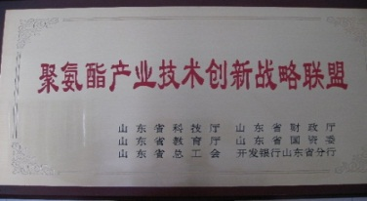
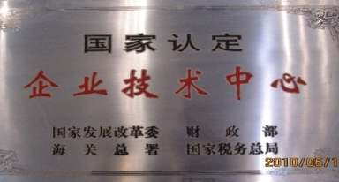
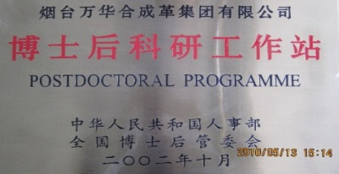
Introduction of Wanhua-BorsodChem
R&D Platform
After acquisition:
Technical optimization in BorsodChem with support from Wanhua technical and research platform→both capacity and quality improved
Sales revenue increased substantially
Deepening cultural integration
2014 ended financial loss and positive profit the first time in past 5 years. Expects more profit in 2015
differentiated and motivating salary increase in 2015
National Polyurethane Engineering Research Center
State Certified Enterprise Technology Center
Post-doctoral Programmer
2 Academy Members’ Research Programmer
3 State Certified Analytical Labs
5 Provincial Research Centers and Key Labs

Slide 12
Introduction of Wanhua-BorsodChem
Wanhua plans to establish Sino-Hungarian Borsod Economic and Trade Cooperation Area as a platform for further investment from Chinese enterprises
€100 million investment on bio-chemical company by one Chinese company, using corn as raw material for production
Negotiation with potential investors continues. Wanhua plays positive role in attracting investment with its background of Chinese company and its successful experience
Chinese government already gave support and favorable policies for subsidies
We wish for equivalent support from Hungary

Slide 13
Thank you for your attention!
Please visit our website: www.borsodchem-group.com

