Slide 1
Future and consequences of the Chinese capital account liberalisation
Zsolt Kuti (Director of Monetary and Financial Analysis)
National Bank of Hungary
26 March 2015
National Bank of Hungary

Slide 2
Presentation outline
China on the road of liberalization
Consequences of Chinese capital account liberalization
Hungary’s role in Chinese opening process
National Bank of Hungary

Slide 3
Presentation outline
China on the road of liberalization
Consequences of Chinese capital account liberalization
Hungary’s role in Chinese opening process
National Bank of Hungary

Slide 4
RMB internationalisation – a global deal is forming
China’s steps
  Capital account liberalisation
  Interest rate liberalisation
  Exchange rate liberalisation
  Development of the financial institutional framework (deposit guarantee scheme, supervision, statistical standards, etc)
Global
  RMB investments by central banks (gain from higher returns and diversification advantages)
  Contribution to the development of RMB money, capital and FX-markets (issuance of RMB bonds, introduction of RMB to stock exchanges, settlement system, etc)
  RMB introduction to SDR currencies
National Bank of Hungary

Slide 5
Past, present and future of reforms
Current account liberalization (from 1980’s-)
  WTO membership (2001)
  Renminbi settlement liberalization (Trade settlement Scheme -Pilot program 2009)
Capital account liberalization
  inflows
    FDI inflows (process started in 1990)
    QFII (Qualifided foreign Institutional Investor) (2003)
    Interbank bond programme, central banks and foreign settlement banks can invest in Chinese bondmarket (2010), NBH is negotiating this issue
    RQFII (RMB – Qualified Foreign Investment Institution) – permit certain foreign RMB investments in Chinese bond and equity market (2011)
    QFII és RQFII quotas increase (2012)
  outflows
    QDII (Qualified Domestic Institutinal Investor) permit conversion to RMB currency and foreign investment opportunities (2006)
    ODI (Overshore Direct Investment) - domestic institutions can take RMB oversea to accomplish FDI investments (2011)
Exchange rate regime and FX liberalization
  Onshore market: Fixed exchange rate regime + liberalized offshore market (CNY, CNH)
  Widening of FX trading band (+/- 1% , 2012) (+/-2% , 2014)
  Broaden onshore quoted currency group (2012 -)
National Bank of Hungary

Slide 6
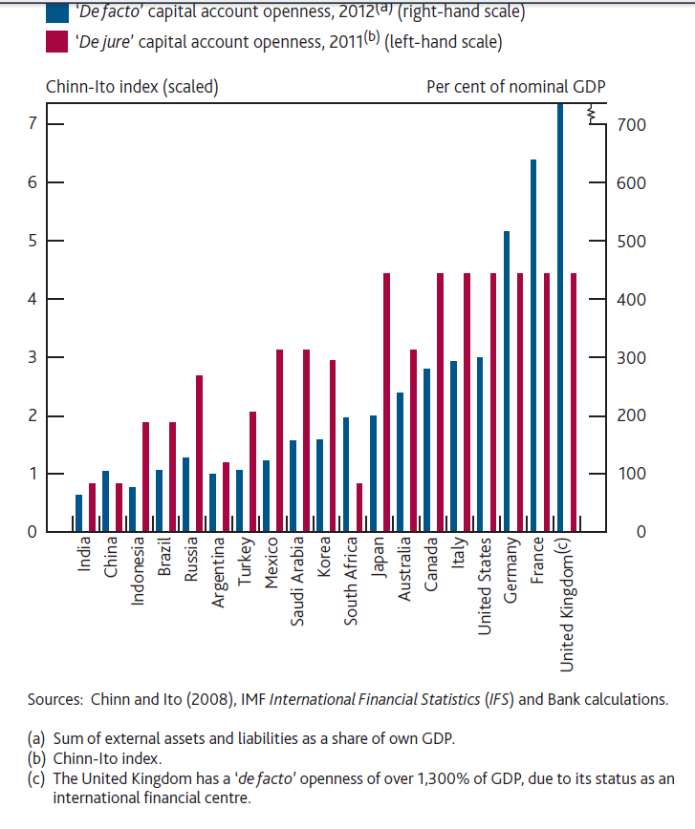
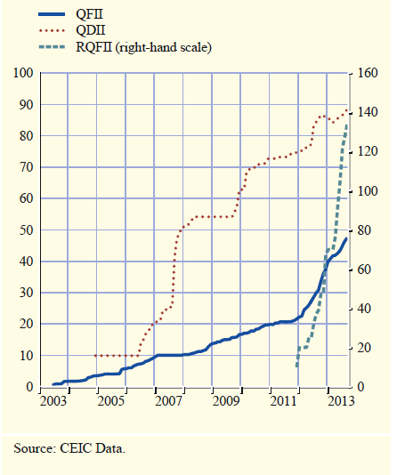
China’s capital account is still closed in international comparision, but it is improving
Capital Account Openness
Investments in QFII, QDII,RQFII programs (bn USD)
National Bank of Hungary

Slide 7
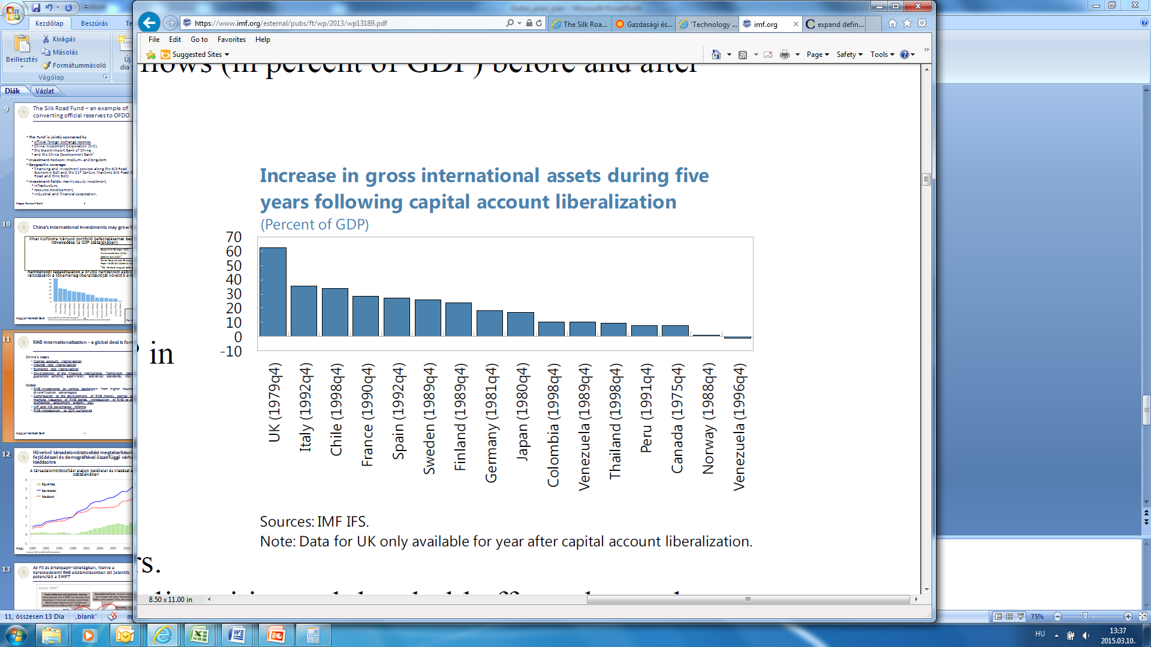
History confirms that international investments may grow fast after abolishing capital controls
Increase in gross international assets during five years following capital account liberalization
Source: IMF

Slide 8
Starting point: closed capital account (China)
Endpoint: opened capital account (US)
    Official reserves account for the vast majority of gross international assets
    Portfolio inflows and outflows may grow the fastest in the future
    FDI inflows may slow down, but FDI outflows may increase
International investment position (as a percentage of the GDP)
National Bank of Hungary
Forrás: IMF IFS

Slide 9
Presentation outline
China on the road of liberalization
Consequences of Chinese capital account liberalization
Hungary’s role in Chinese opening process
National Bank of Hungary

Slide 10
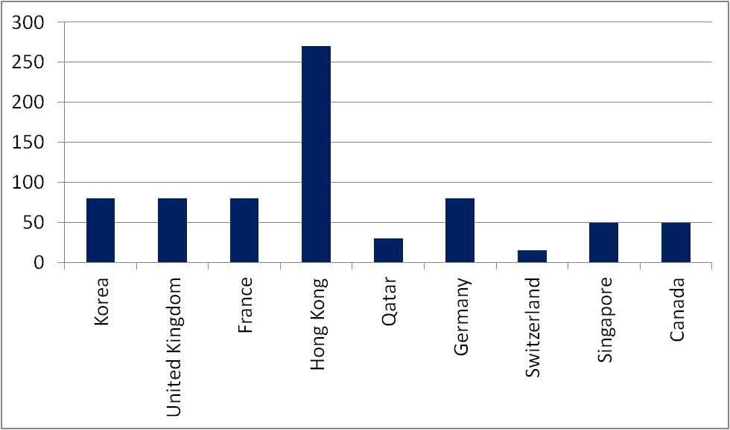
RQFII investment quotas are expanding in size and covering more and more countries (bn yuan)
National Bank of Hungary

Slide 11
„China goes abroad”- more OFDI, stabilising IFDI
Inward and outward FDI stock (bn USD)
Forrás: UNCTAD, FDI/TNC database (www.unctad.org/fdistatistics).
National Bank of Hungary
Notes:
Outward FDI - expansion
„China goes abroad”
Brand purchases (Volvo, Hummer, MG, CMAE)
Exportmarket expansion
Strategic resource aquisitions (mines in Africa, Australia, …)
Inward FDI - decline
Intense competition, narrower domestic profits
Slower economic growth

Slide 12
The Silk Road Fund – an example of converting official reserves to outward FDI
The Fund is jointly sponsored by
  official foreign exchange reserves,
  China Investment Corporation (CIC),
  the Export-Import Bank of China,
  and the China Development Bank”
Investment horizon: medium- and long-term
Geographic coverage:
  financing and investment services along the Silk Road Economic Belt and the 21st Century Maritime Silk Road
Investments: mainly equity investments
  infrastructure
  resource development
  industrial and financial cooperation
National Bank of Hungary

Slide 13
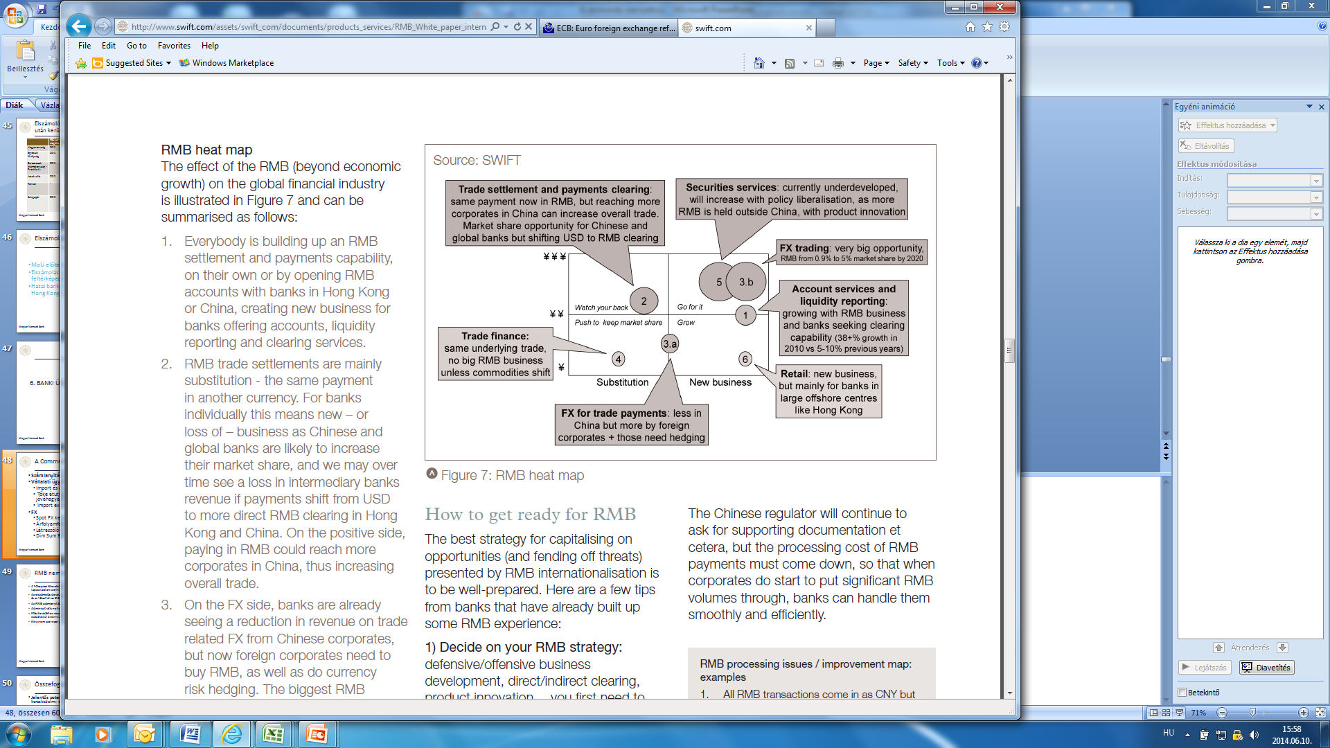
FX trading and securities services may grow fastest in the RMB market
Source: SWIFT
National Bank of Hungary

Slide 14
Presentation outline
China on the road of liberalization
Consequences of Chinese capital account liberalization
Hungary’s role in Chinese opening process
National Bank of Hungary

Slide 15
Hungary has a unique position among CEE countries regarding RMB
Renminbi Initiatives across Europe
National Bank of Hungary

Slide 16
Opportunities for Hungary with Budapest Renminbi Programme
Increasing trade financing with RMB, decreasing vulnerability via diversification (swap line)
Potential Chinese government bond investors through RQDII and potential investment outflow to China through RQFII
Potential increase in China-Hungary bilateral FDI flows
Potential development of capital markets, clearing and settlement infrastructure
To seize all this opportunities MNB should meet risk mitigation requirements („Cross the river by feeling the stones”)
National Bank of Hungary

Slide 17
Co-operation and more work going forward
Swap line (signed in 2013)
Central bank instruments in case of emergency
FX portfolio construction (RQFII quota)
Clearing and settlement infrastructure development (local Chinese bank assigment)
Financial stability and supervisory role…
National Bank of Hungary

Slide 18
Thank you for your attention!

